Slide 1
Petabytes of Data - How to Use R at Scale
Jeff Fletcher

Slide 2
AGENDA
WHAT PROBLEM ARE WE SOLVING?
HOW IS IT SOLVED OUTSIDE OF R?
COMPONENTS OVERVIEW
HOW DOES THIS WORK WITH R?
USEFUL THINGS TO KNOW
GETTING STARTED

Slide 3
WHAT PROBLEM ARE WE SOLVING?

Slide 4

WHAT PROBLEM ARE WE SOLVING?
Your MacBook, while very cool and shiny is too small for the enormous amounts of data used by actual enterprise companies.

Slide 5
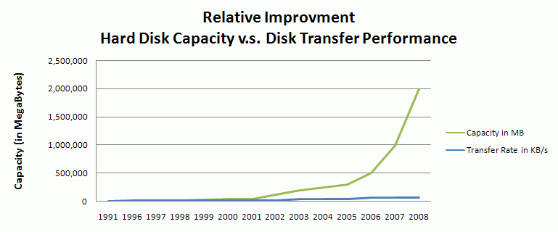
WHAT PROBLEM ARE WE SOLVING?
Notes:
Single node problem
*HDD size
Using the big data stack
DS over bigger data and a longer time
Security concerns / portable data
*ML at Scale / Branko

Slide 6
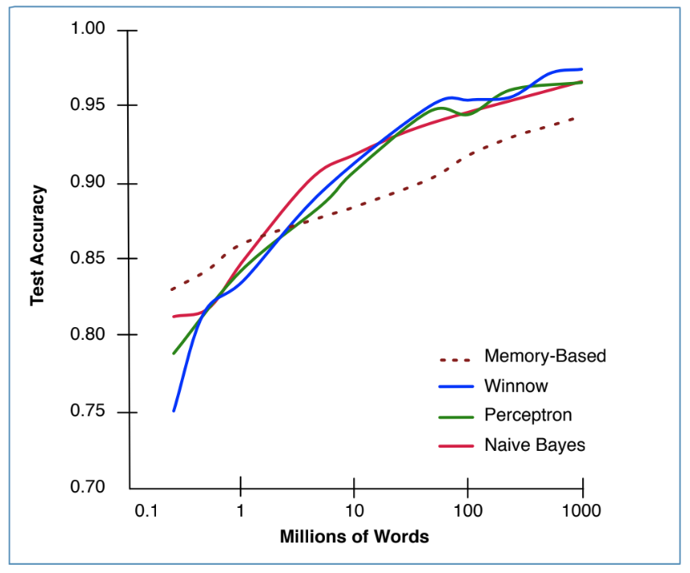
WHAT PROBLEM ARE WE SOLVING?
“It’s not who has the best algorithms that wins. It’s who has the most data.” [Banko and Brill, 2001]
Notes:
Single node problem
*HDD size
Using the big data stack
DS over bigger data and a longer time
Security concerns / portable data
*ML at Scale / Branko

Slide 7
HOW IS THIS SOLVED OUTSIDE OF R?

Slide 8

HOW IS THIS SOLVED OUTSIDE OF R?
One of the many Jeff Dean facts:
Jeff Dean's PIN is the last 4 digits of pi.
The rest are funny-ish, but a good way to kill 20 mins on a many person webex.

Slide 9


HOW IS THIS SOLVED OUTSIDE OF R?
Most of my colleagues who visit SA ask if they can eat some Impala. And Kudu. It’s our other thing. African antelope are the spirit animals of database developers it seems.

Slide 10
A QUICK HADOOP OVERVIEW

Slide 11
HDFS
Data Nodes
Name Node
File 1
File 2

Slide 12

YARN
Data Nodes
NODE MANAGER
Resource Manager
CONTAINER
APP MASTER
NODE MANAGER
APP MASTER
CONTAINER
NODE MANAGER
CONTAINER
CONTAINER

Slide 13
HADOOP STACK
Hive
MapReduce
Our template says I should put some related text here. How about - this layout was approved by Piet Mondrian.
YARN
HDFS

Slide 14
IMPALA OVERVIEW

Slide 15
HADOOP STACK WITH IMPALA
Hive
IMPALA
MapReduce
A Dutch painter and theoretician who is regarded as one of the greatest artists of the 20th century. Painty Piet I like to call him.
YARN
HDFS

Slide 16
SPARK OVERVIEW

Slide 17
HADOOP STACK WITH SPARK
Hive
SPARK
MapReduce
He proclaimed in 1914: Art is higher than reality and has no direct relation to reality…
According to Wikipedia anyway. I didn’t hear him say it.
YARN
HDFS

Slide 18
SPARK
Data Nodes
Resource Manager
Client Program
EXECUTOR
TASK
TASK
Spark Driver
EXECUTOR
TASK
TASK

Slide 19
SPARK RDD
Node
Node
Node
Node
YARN
SPARK
HDFS

Slide 20
SPARK RDD
Map
Filter
GroupBy
Join
Take
Map

Slide 21
SPARK DATAFRAME
Notes:
RDD of Type Row
Headers and Schema
Parquet

Slide 22
SPARK LIBRARIES
SQL
Streaming
MLlib
GraphX
SPARK
Apart from libraries, there are many books on Spark. Look for stuff by Holden Karau.
YARN
HDFS
Notes:
All upgraded at the same time

Slide 23
HOW DOES THIS WORK WITH R?

Slide 24

R vs Python
Scala wins, obviously!

Slide 25

HOW DOES THIS WORK WITH R?
implyr
delay <- flights_tbl %>%
select(tailnum, distance, arr_delay) %>%
group_by(tailnum) %>%
summarise(count = n(), dist = mean(distance), delay = mean(arr_delay)) %>%
filter(count > 20L, dist < 2000L, !is.na(delay)) %>%
arrange(delay, dist, count) %>%
collect()

Slide 26
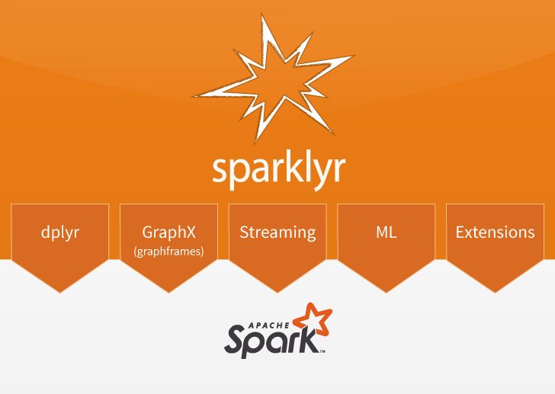
SPARKLYR
The silver medal goes to SparkR. Sparklyr 1.0.0 has most of the things you need and support for Arrow.
Notes:
And SparkR

Slide 27
SPARKLYR
Data Nodes
EXECUTOR
Client Program
TASK
TASK
RM
R
R
R
Sparklyr
Spark Driver
EXECUTOR
TASK
TASK
R
R
Notes:
spark_apply()

Slide 28

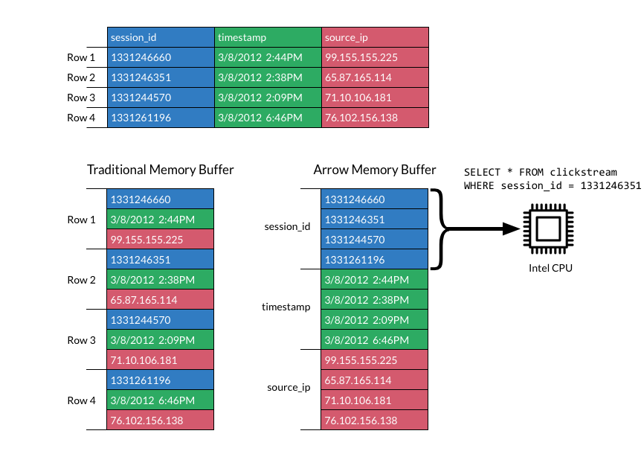
APACHE ARROW
High speed in memory data processing for everybody!

Slide 29
USEFUL THINGS TO KNOW

Slide 30

LAZY EVALUATION
This catches people out when working on the command line. Entered does not mean executed.

Slide 31
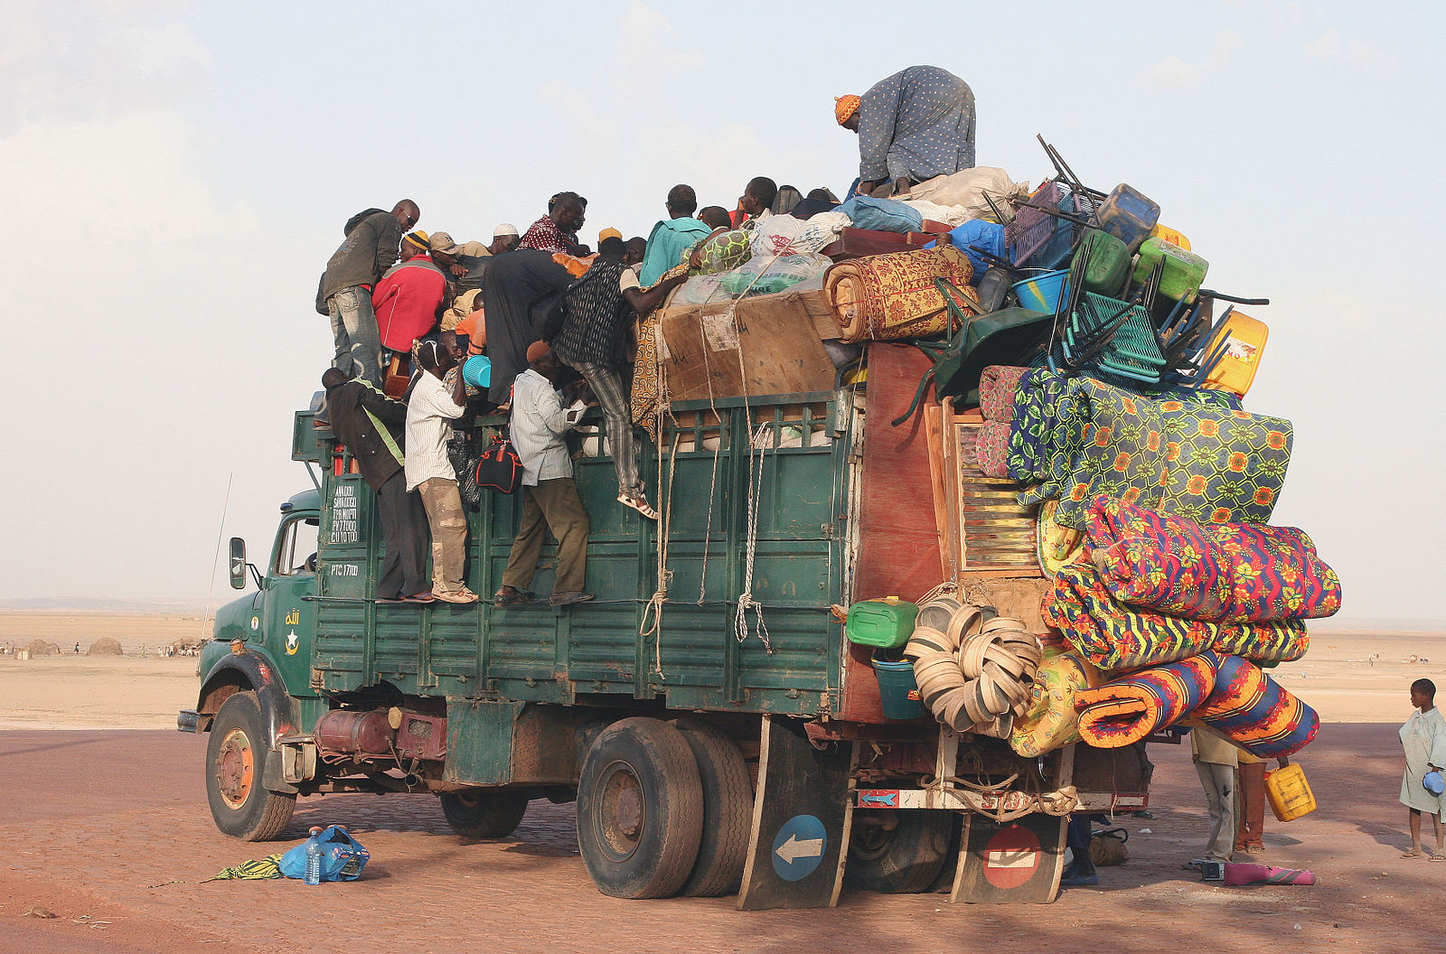
OVERLOADING THE DRIVER
I see this often when talking with data science teams. It’s part of the standard operating procedure for “small data” data science work.

Slide 32
DATAFLOW
We’re moving into data engineering territory here but the pay is good and coffee is fair trade, locally sourced.

Slide 33

AVOID GROUPBYKEY
Use ReduceByKey. All the cool kids are doing it.

Slide 34
CHECK FOR DATA SKEW
I did not spend a lot of time drawing this. But Edward Tufte would be proud. Very favourable data to ink ratio.

Slide 35
CHECK FOR DATA SKEW
You can avoid this by adding salt to the keys. Definitely no easy set up for a joke with that.

Slide 36
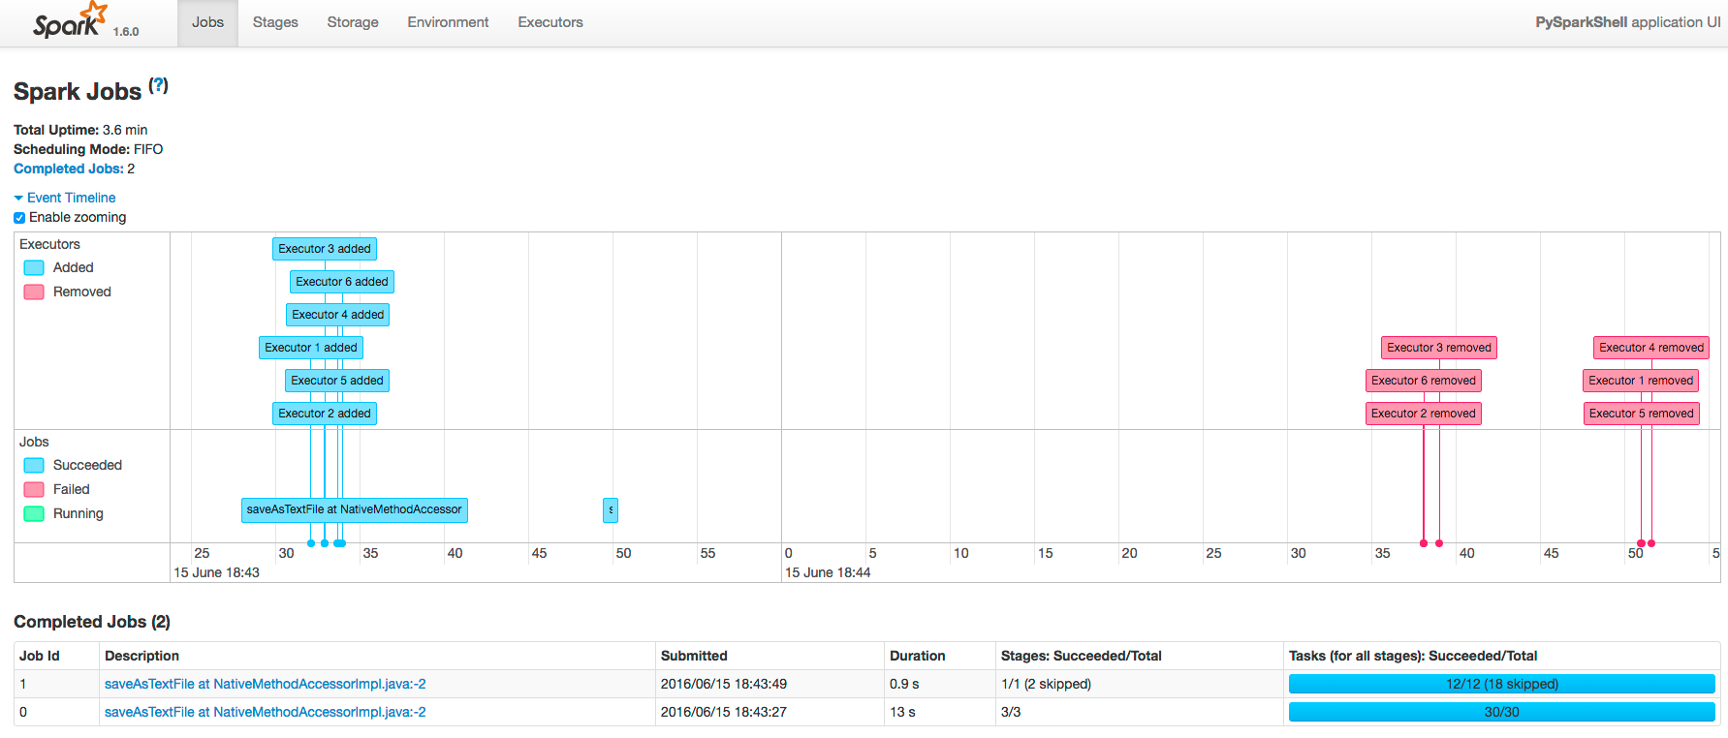
USE THE SPARK UI

Slide 37
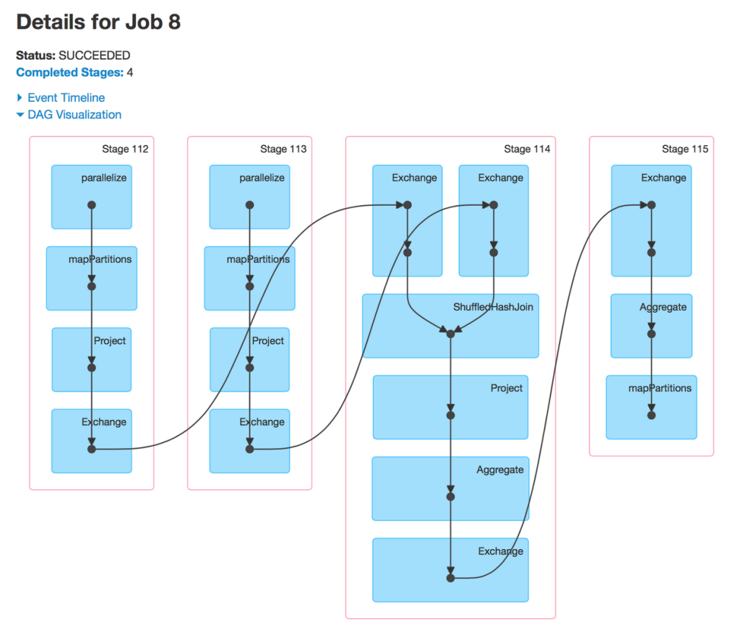
DAG
Directed Acyclic Graph - Use the full title if you want to sound smarter while talking data scientists.

Slide 38
GETTING STARTED

Slide 39
GETTING STARTED
Implyr
https://blog.cloudera.com/blog/2017/07/implyr-r-interface-for-apache-impala/
https://github.com/ianmcook/implyr
Sparklyr
https://blog.cloudera.com/blog/2016/09/introducing-sparklyr-an-r-interface-for-apache-spark/ https://spark.rstudio.com/
Spark
https://www.cloudera.com/documentation/enterprise/5-16-x/PDF/cloudera-spark.pdf https://www.cloudera.com/products/open-source/apache-hadoop/apache-spark.html

Slide 41
IMAGES USED
Most diagrams I either drew or took from Cloudera’s documentation directly. The rest come from here:
https://www.apple.com/shop/buy-mac/macbook-pro/15-inch-space-gray-2.6ghz-6-core-512gb
http://web.cs.ucla.edu/classes/winter13/cs111/scribe/10c/
https://commons.wikimedia.org/wiki/File:Special_Edition_NYC_2015_-_DC_vs_Street_Fighter_(18357923460).jpg
https://commons.wikimedia.org/wiki/File:Overloaded_truck.jpg
https://www.publicdomainpictures.net/en/view-image.php?image=220900&picture=two-lazy-bears
https://www.goodfreephotos.com/other-photos/lots-of-keys.jpg.php

